Slide 1

Zbyszko Papierski
MAY 2024
LLM
Search Engine Killer?

Slide 2

https://sli.do/geecon
Speaker’s Name

Slide 3

LLM—Search Engine Killer?
Zbyszko Papierski

Slide 4
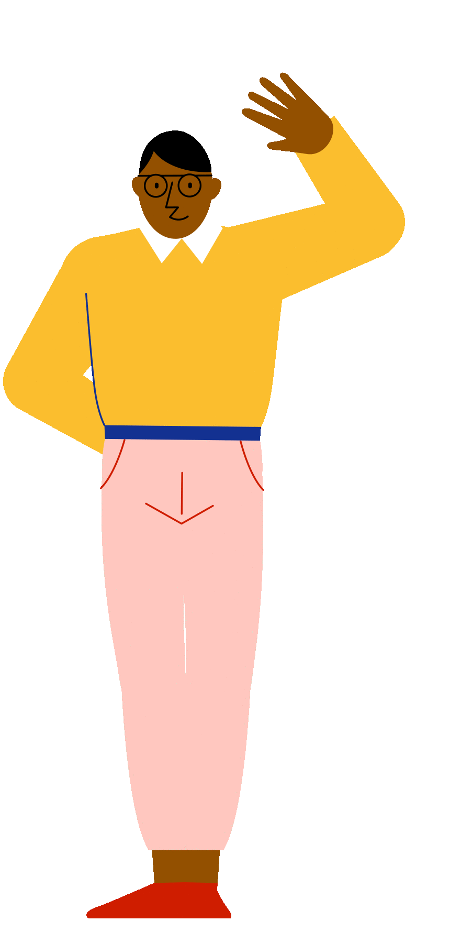
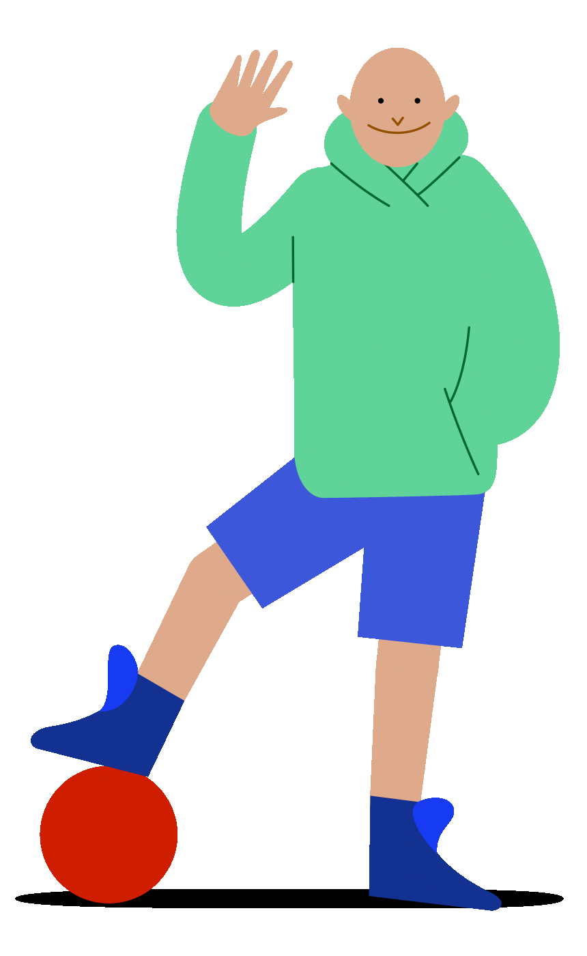

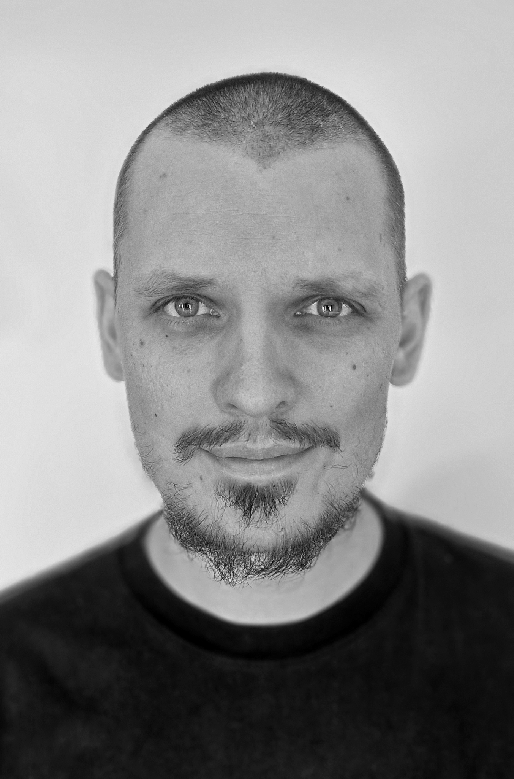
WHO AM I?
ZBYSZKO PAPIERSKI
Search Domain Lead @Brainly
Tricity JUG organizer

Slide 5
Disclaimer!!
Search Engineer, not a Machine Learning Engineer

Slide 6
2022

Slide 7
Add Search, you say? Sounds easy, right?
by Zbyszko Papierski

Slide 8
“Do you think you’ll work will change dramatically considering rise of ChatGPT?”

Slide 9
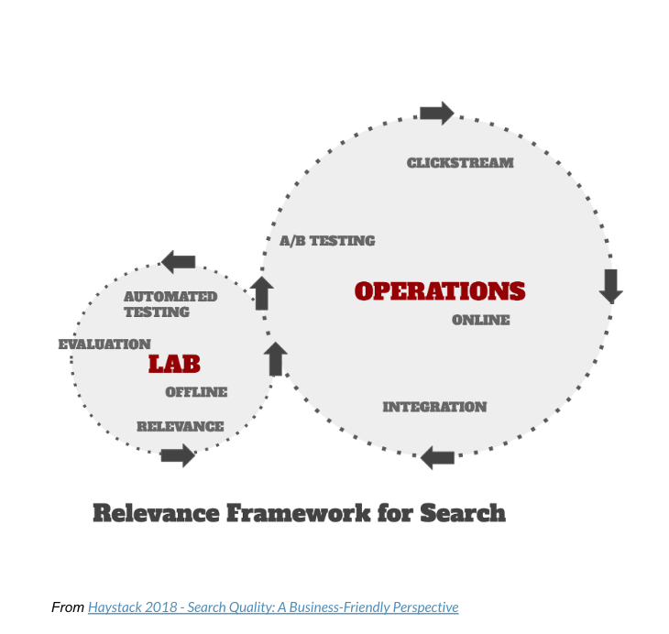
What’s search engineering?

Slide 10
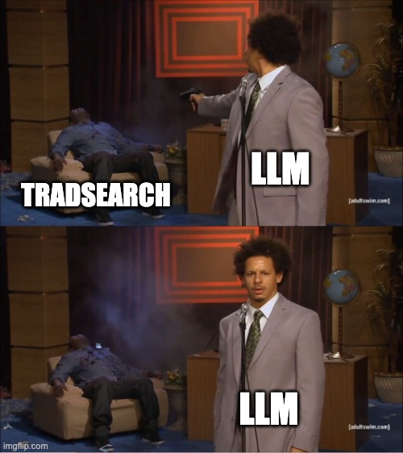

Slide 11
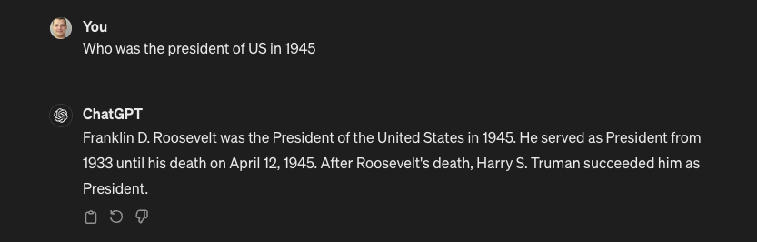
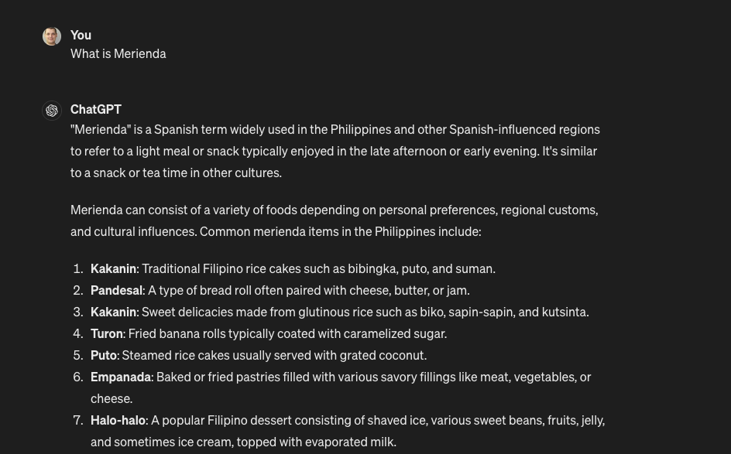


Slide 12
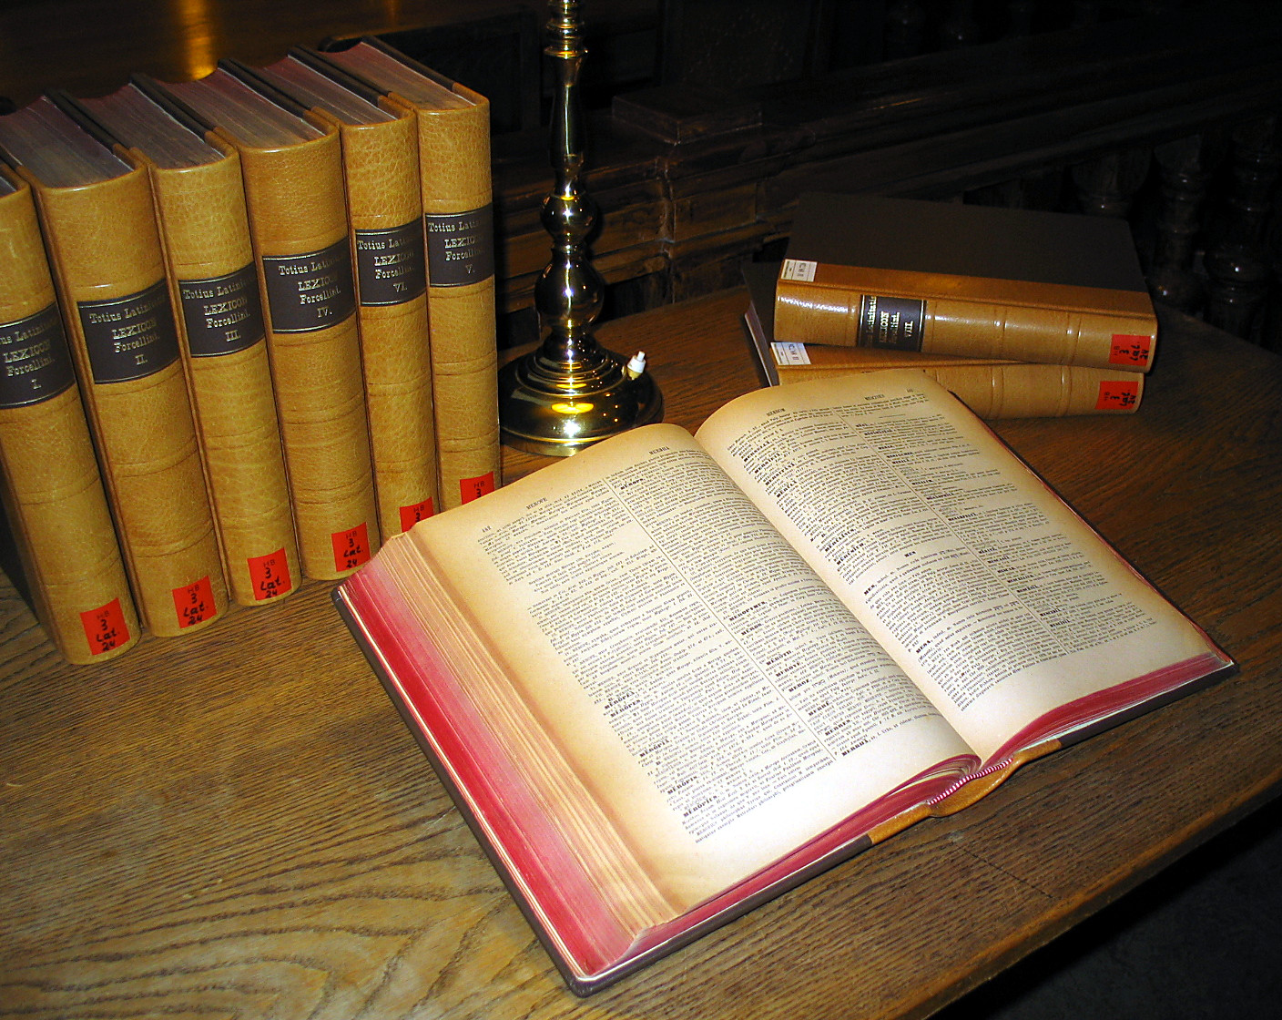
Information
Retrieval

Slide 13





Information retrieval (IR)[...] is the task of identifying and retrieving [information] that are relevant to an information need.
via Wikipedia

Slide 14
The term information need is [...] desire to locate and obtain information to satisfy a [...] need.
via Wikipedia

Slide 15
PART I
FULL TEXT SEARCH, NICE TO MEET YOU

Slide 16


Slide 17
Tokens
DocFreq
PostingsList
bike
7
1,4,6,10,13,15,16
winter
6
1,6,12,13,18,19
cat
6
2,4,5,12,13,16
deal
5
2,4,12,13,16

Slide 18
Riding a bike in the middle of the winter

Slide 19
ride, bike, middle, winter

Slide 20
docId:20
ride
bike
middle
winter
Inverted Index

Slide 21
Tokens
DocFreq
PostingsList
bike
8
1,4,6,10,13,15,16,20
winter
7
1,6,12,13,18,19,20
cat
6
2,4,5,12,13,16
ride
6
2,4,12,13,16,20
middle
1
20

Slide 22
Query:
bike, ride, middle, january

Slide 23
Query:
bike, ride, middle, january
Tokens
DocFreq
PostingsList
bike
8
1,4,6,10,13,15,16,20
winter
7
1,6,12,13,18,19,20
cat
6
2,4,5,12,13,16
ride
6
2,4,12,13,16,20
middle
1
20

Slide 24
Query
What bikes are good for riding in the middle of a forest in summer?

Slide 25
How to capture a semantic meaning of the query and the documents?

Slide 26
PART II
“FIRST” MACHINE LEARNING REVOLUTION

Slide 27

Bidirectional
Encoder
Representations from
Transformers

Slide 28
Masked
Language
Modeling
Chcecie coś z Avonu?

Slide 29
Masked
Language
Modeling
How to ride a [MASKED] in the middle of winter?
Chcecie coś z Avonu?

Slide 30
Next
Sentence
Prediction
Riding a bike in winter requires preparation. Your first step should be to make sure your tires are at least 4 inch wide.
VS
Riding a bike in winter requires preparation. Downtown kebabs are a blast!

Slide 31
What bikes are good for winter riding?

Slide 32
What bikes are good for winter riding?
“what”, “bikes”, “are”, “good”, “for”, “winter”, “riding”,”?”

Slide 33
What bikes are good for winter riding?
“what”, “bikes”, “are”, “good”, “for”, “winter”, “riding”,”?”
[CLS],20, 4123, 211, 8272, 23422, 1231, 14323,44553, [PAD]

Slide 34
What bikes are good for winter riding?
“what”, “bikes”, “are”, “good”, “for”, “winter”, “riding”,”?”
[CLS], 20, 4123, 211, 8272, 23422, 1231, 14323,44553, [PAD]
[0.22,-0.2,0.45...]
[0.1,-0.2,0.23...]
[0.65,-0.2,0.32...]
[0.26,-0.2,0.25...]
[-0.22,-0.2,0.13
[0.15,-0.2,0.11...]
[0.98,0.2,0.45...]
[0.1,-0.2,0.2...]
Pooling Layer
[0.22,0.1,-0.3…]

Slide 35
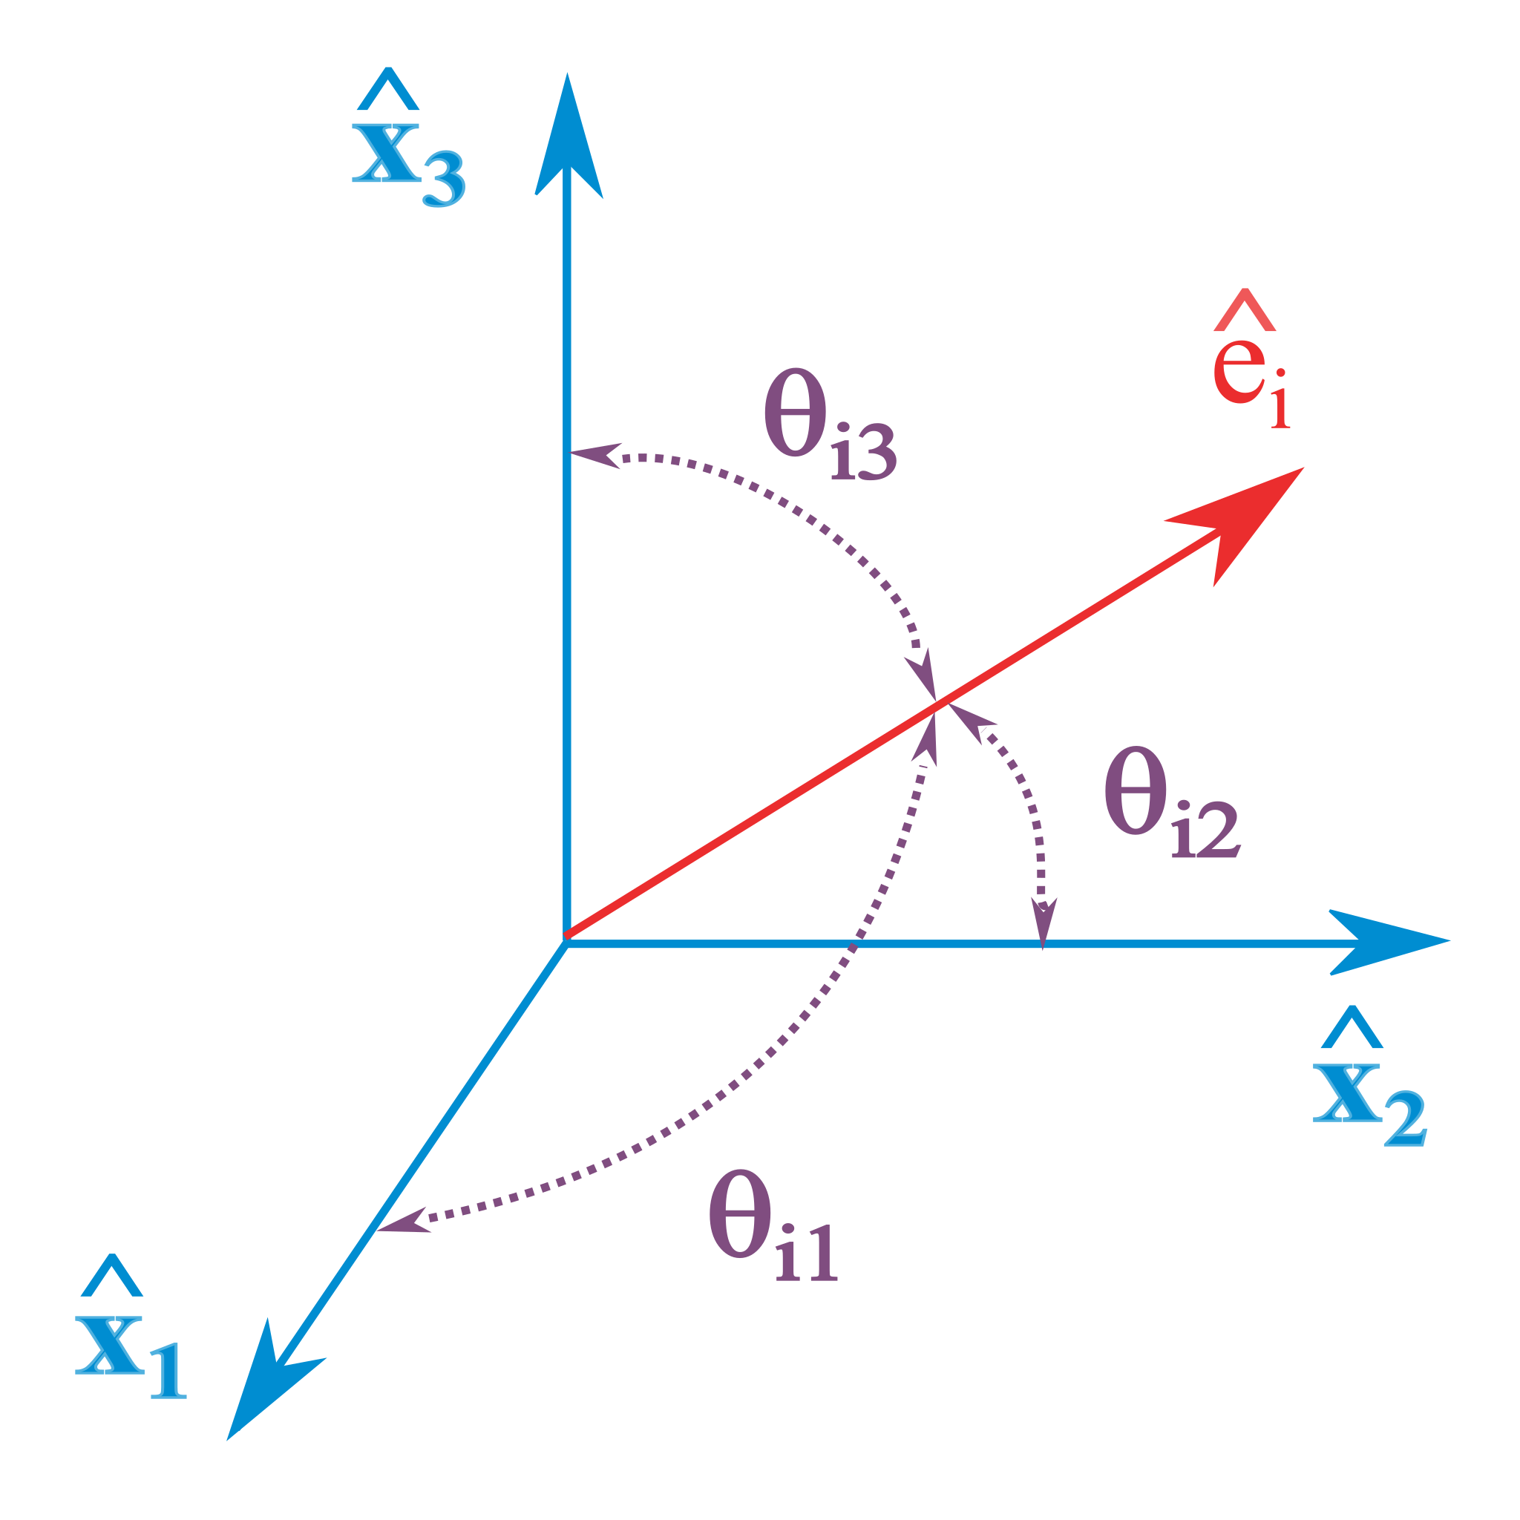
Semantic
similarity

Slide 36
Semantic
similarity
Man
Woman
King
Queen

Slide 37
ANALYZE
VS
SYNTHESIZE

Slide 38
PART III
SECOND MACHINE LEARNING REVOLUTION

Slide 39
Generative
Large
Language
Model

Slide 40
Focused on next token prediction
The sky is
blue | 0.3
grey | 0.26
lovely | 0.2
underpants | 0.0002
brutal | 0.002

Slide 41
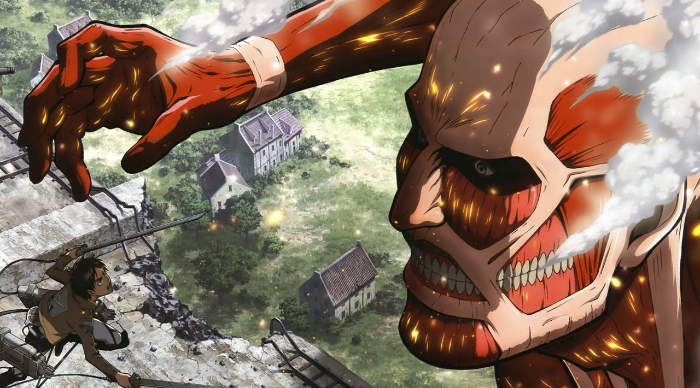
GPT3 (45TB)
*BERT*
(3TB)

Slide 42
PART IV
READING THE FINE PRINT UNDER LLM

Slide 43
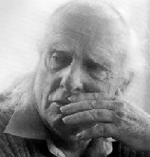
LLMs don’t really know the truth (*)
The maxim of QUANTITY
The maxim of QUALITY
The maxim of RELATION
The maxim of MANNER
Herbert Paul Grice
Notes:
The maxim of quantity, where one tries to be as informative as one possibly can, and gives as much information as is needed, and no more.
The maxim of quality, where one tries to be truthful, and does not give information that is false or that is not supported by evidence.
The maxim of relation, where one tries to be relevant, and says things that are pertinent to the discussion.
The maxim of manner, when one tries to be as clear, as brief, and as orderly as one can in what one says, and where one avoids obscurity and ambiguity

Slide 44

Knowledge is only valid until the model was trained
Photo of the current US president

Slide 45
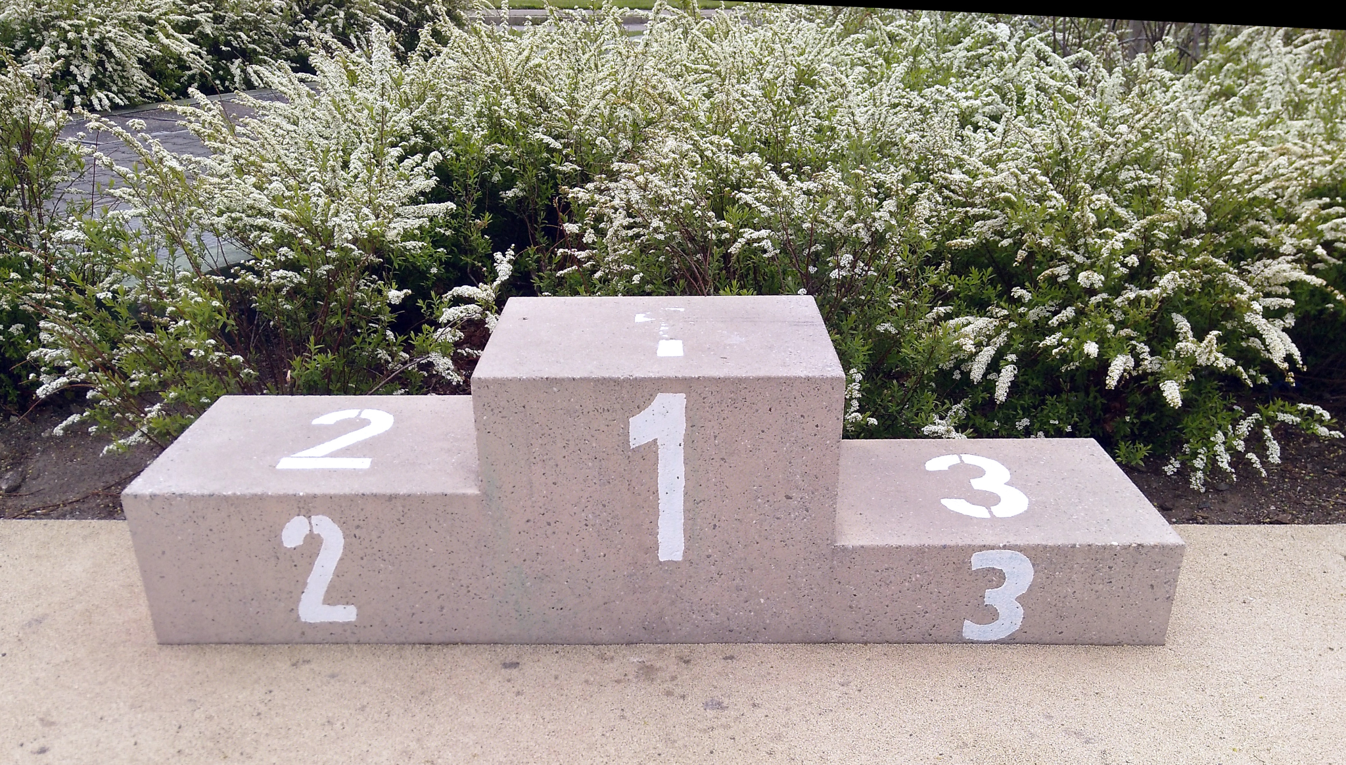

Slide 46
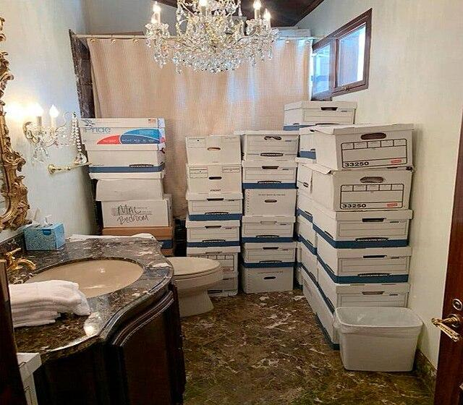
LLM doesn’t know what it doesn’t know
Notes:
Internal stuff

Slide 47
PART V
TYING IT ALL TOGETHER

Slide 48
BERT classifies, GPT/LLaMa generates
Notes:
The maxim of quantity, where one tries to be as informative as one possibly can, and gives as much information as is needed, and no more.
The maxim of quality, where one tries to be truthful, and does not give information that is false or that is not supported by evidence.
The maxim of relation, where one tries to be relevant, and says things that are pertinent to the discussion.
The maxim of manner, when one tries to be as clear, as brief, and as orderly as one can in what one says, and where one avoids obscurity and ambiguity

Slide 49
Retrieval
Augmented
Generation
Notes:
The maxim of quantity, where one tries to be as informative as one possibly can, and gives as much information as is needed, and no more.
The maxim of quality, where one tries to be truthful, and does not give information that is false or that is not supported by evidence.
The maxim of relation, where one tries to be relevant, and says things that are pertinent to the discussion.
The maxim of manner, when one tries to be as clear, as brief, and as orderly as one can in what one says, and where one avoids obscurity and ambiguity

Slide 50
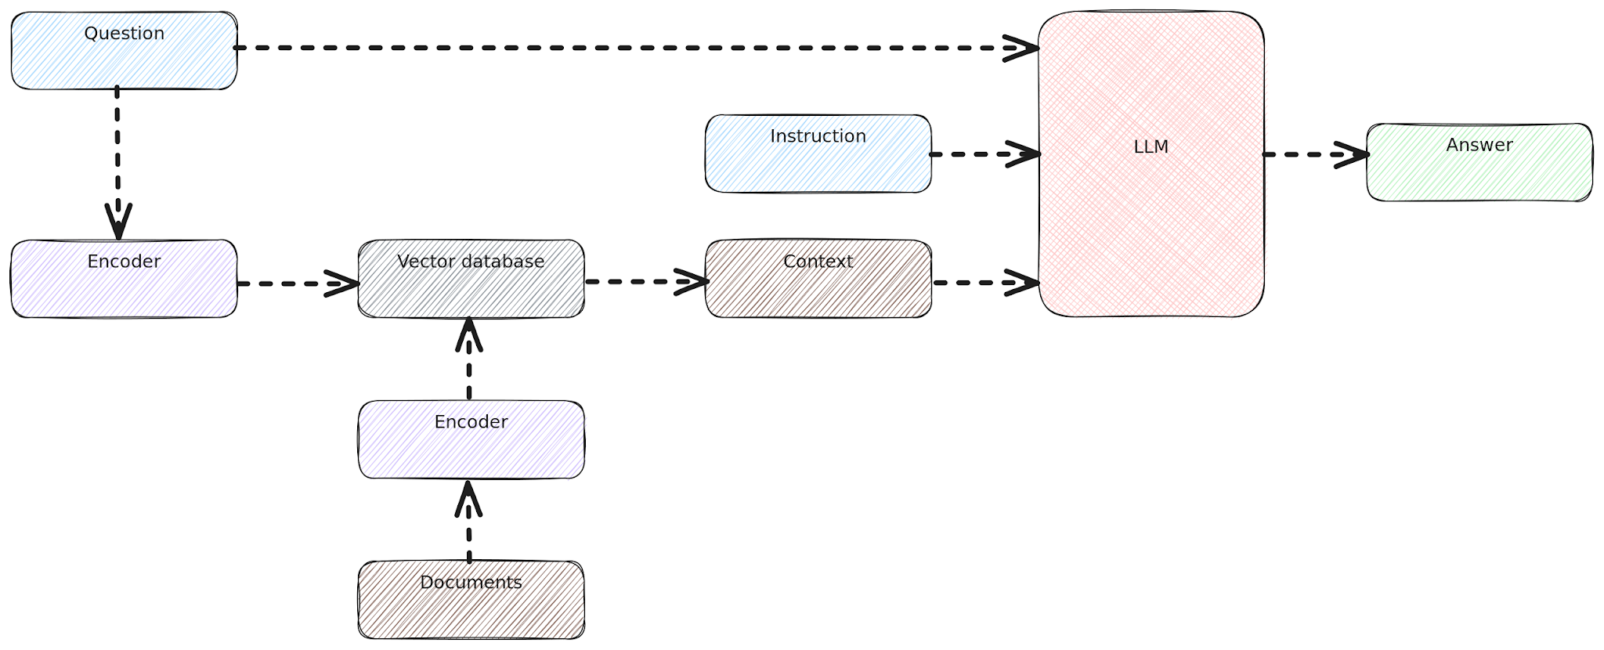
R
A
G
Notes:
The maxim of quantity, where one tries to be as informative as one possibly can, and gives as much information as is needed, and no more.
The maxim of quality, where one tries to be truthful, and does not give information that is false or that is not supported by evidence.
The maxim of relation, where one tries to be relevant, and says things that are pertinent to the discussion.
The maxim of manner, when one tries to be as clear, as brief, and as orderly as one can in what one says, and where one avoids obscurity and ambiguity

Slide 51
PART VI
DRAMATIS PERSONAE

Slide 52

Opensearch with KNN
Hybrid search engine, fork of Elasticsearch

Slide 53

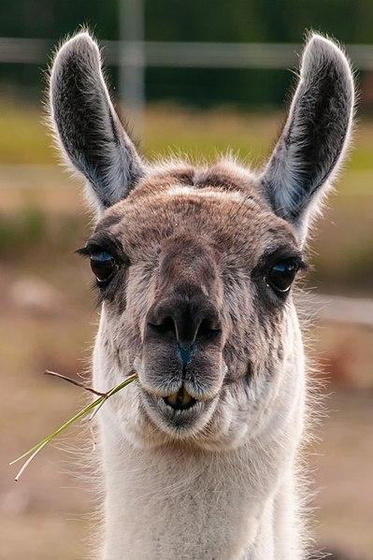
LLama 3 8b (served from ollama)

Slide 54
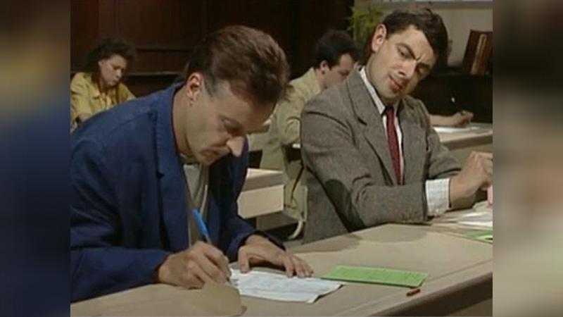
MiniLM
BERT
MiniLM

Slide 55

4j

Slide 56
AUTHOR’S NAME SURNAME
PART VII
DEMO

Slide 57
“Do you think you’ll work will change dramatically considering rise of ChatGPT?”

Slide 58
“Do you think you’ll work will change dramatically considering rise of ChatGPT?”
No, not really.

Slide 59
AUTHOR’S NAME SURNAME
THE END

Slide 60
Sources
https://commons.wikimedia.org/wiki/File:Latin_dictionary.jpg
https://en.wikipedia.org/wiki/File:Archie_search_engine.png
https://commons.wikimedia.org/wiki/File:Donald_Trump_official_portrait.jpg
https://commons.wikimedia.org/wiki/File:Meta-Logo.png
https://python.langchain.com/docs/get_started/introduction
https://commons.wikimedia.org/wiki/File:18-08-25-%C3%85land_RRK6596a.jpg\
https://upload.wikimedia.org/wikipedia/commons/3/37/RAG_schema.svg

